Slide 1
Game Double win
Java Project
Team:
4_Tan bunsoon
22_Leang Khunchheang

Slide 2
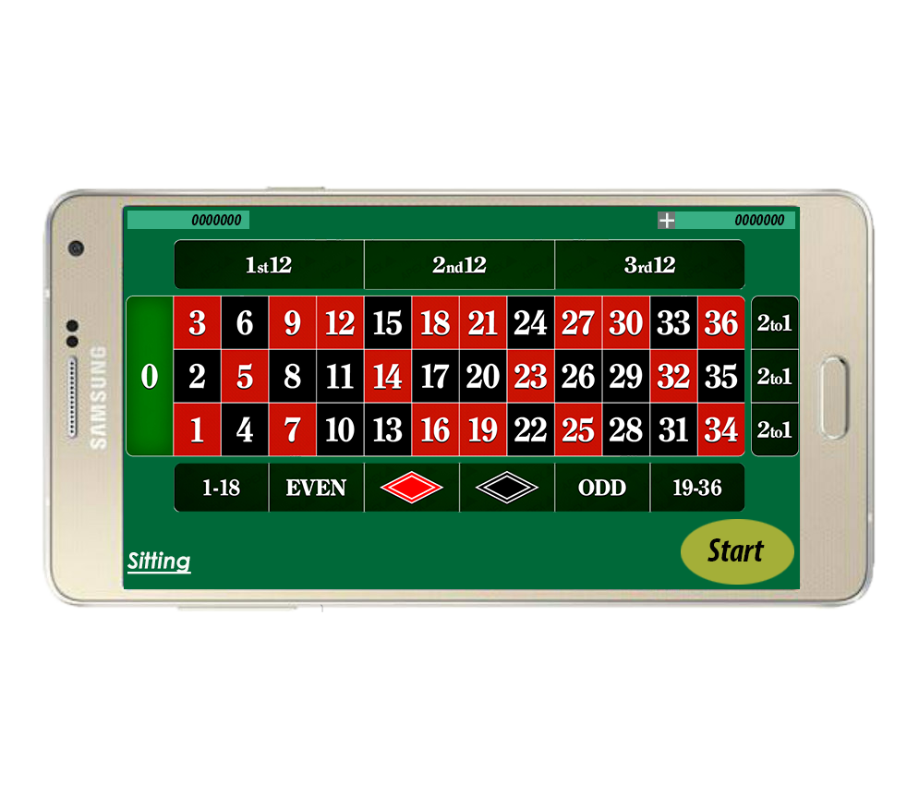

Slide 3
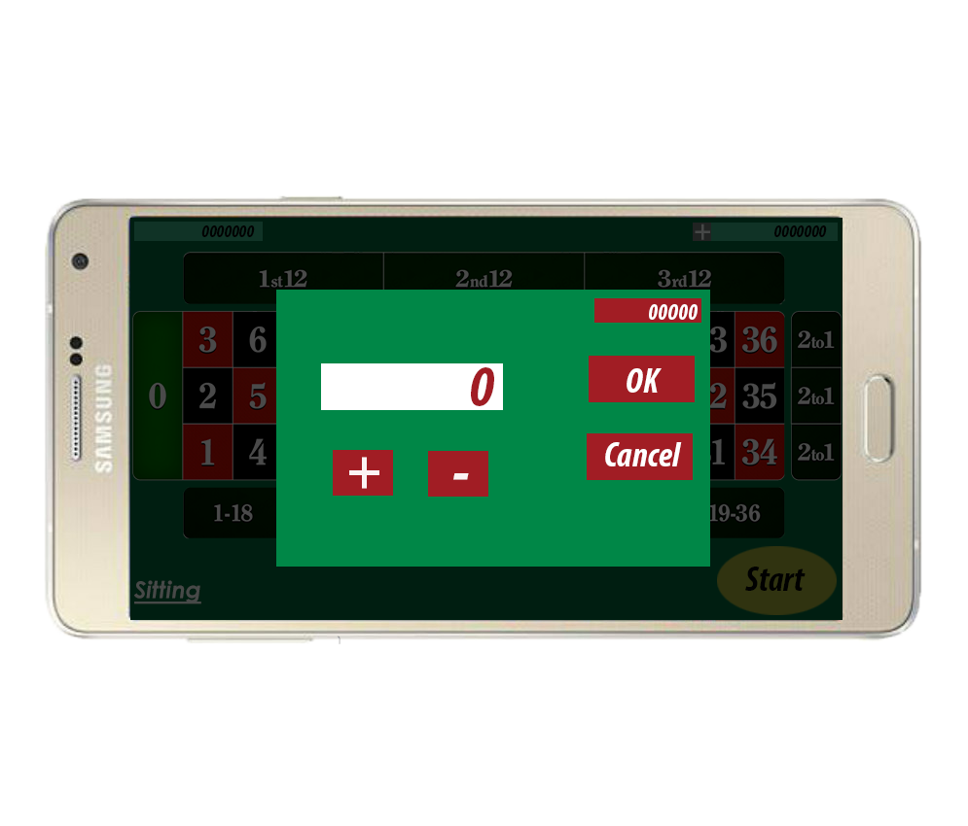

Slide 5
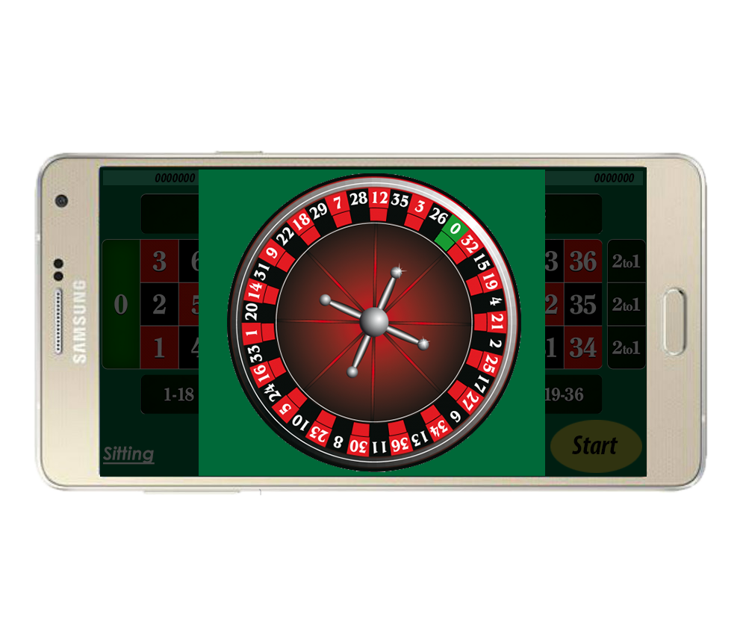

Slide 6
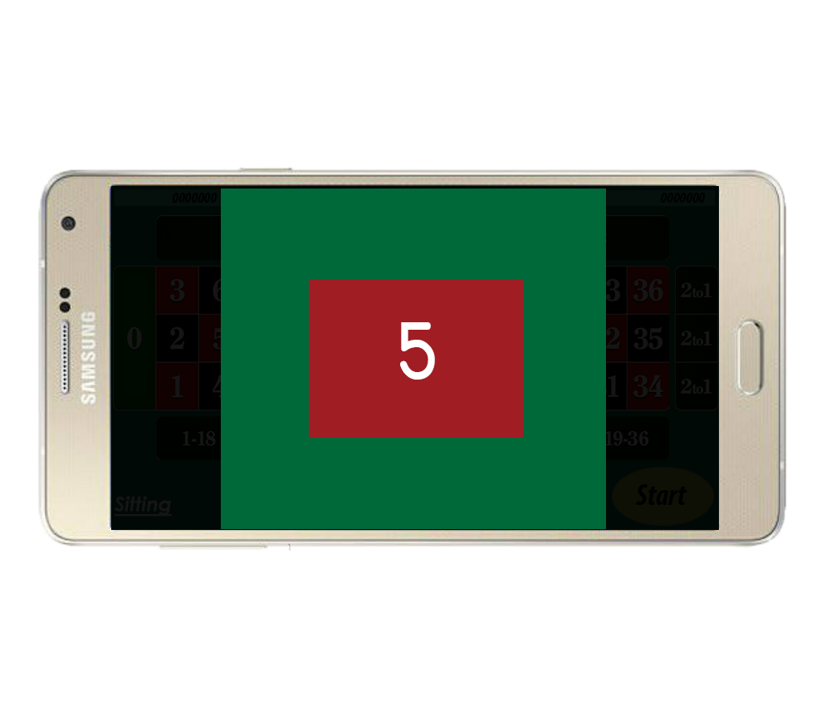

Slide 8
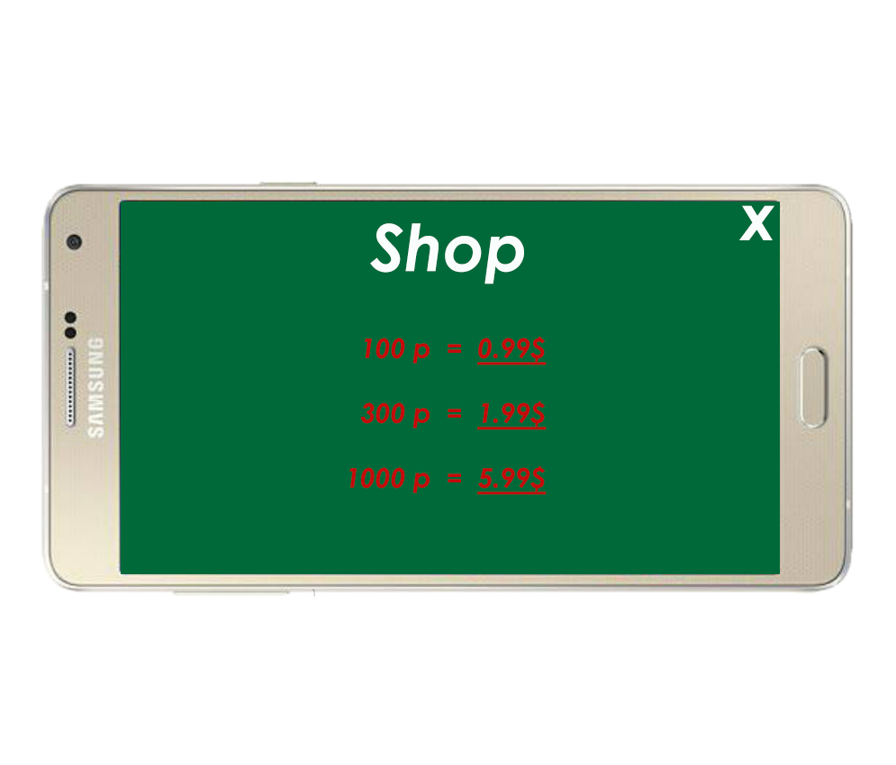

Slide 10
